Slide 1
ADIDAS SALES REPORT FOR YEAR 2020/2021 1.I analyse the key indicators for adidas sales to gain insight into the business performance. 2. I visualize various aspects of adidas sales to gain insight and understand key trends. Based on daily, monthly, year sales trend. Tools use: PYTHON, MICROSOFT- POWERPOINT DATA SOURCE: KAGGLE 1.Data visualization To show some trend on the data sales and gain insight on performance using EDA(EXPLORATORY DATA ANALYSIS) 3. Presentation The findings and visualizations were complied into a presentation using Microsoft Power Point

Slide 2
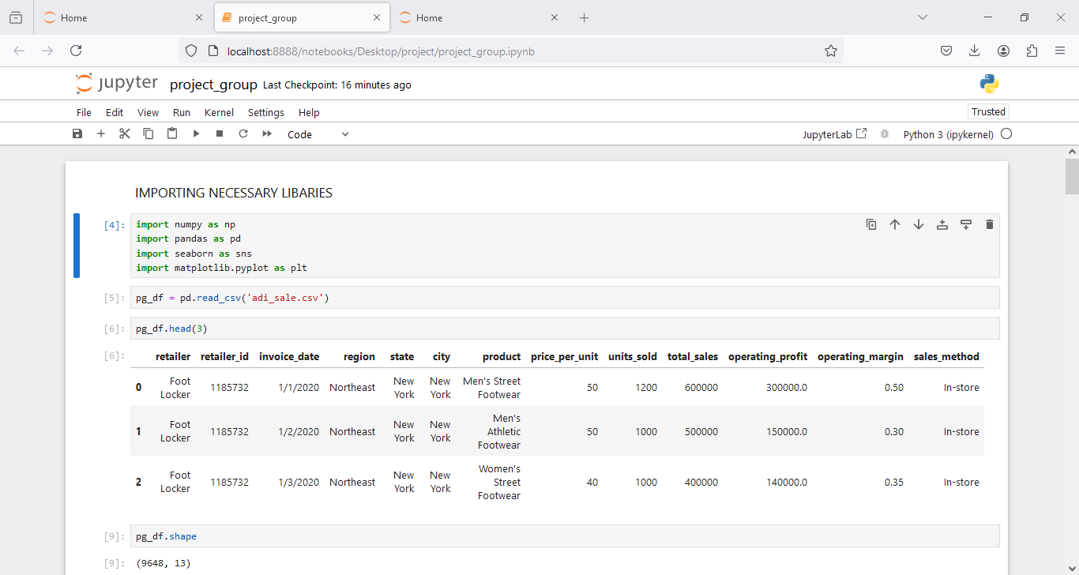

Slide 3
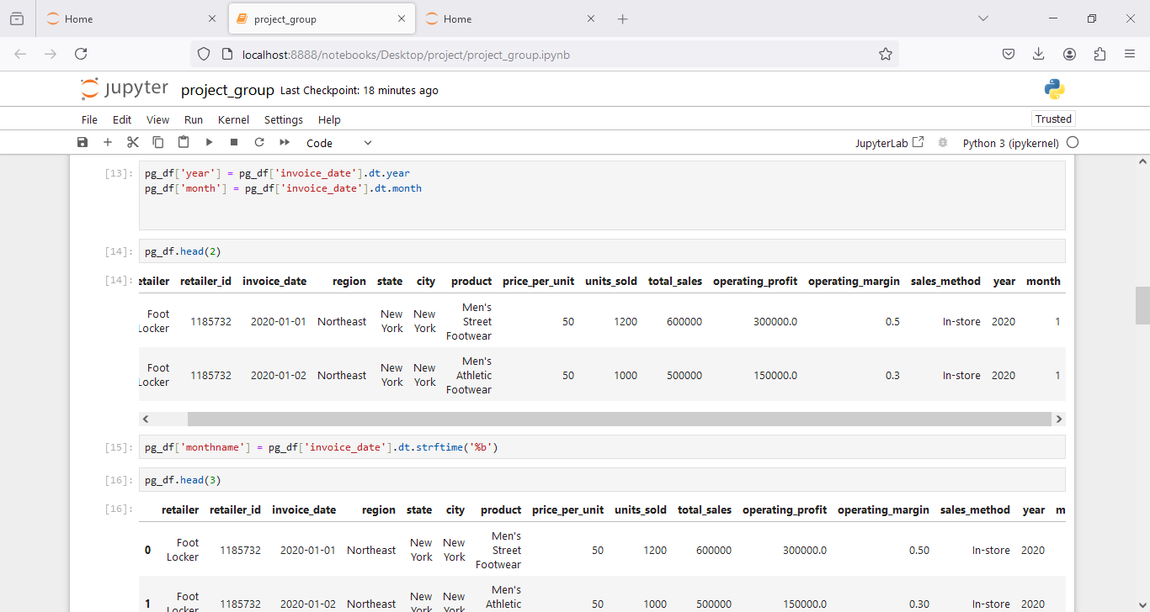

Slide 4
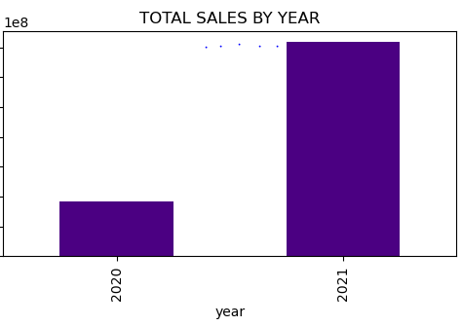
SALES PERFOMANCES OVER TIME
INSIGHTS: TOTAL SALES MADE IN YEAR 2021($717,821,450),WHICH IS four times that of year 2020($182,080,675).
2021: $717,821,450.
2020: $182,080,675.

Slide 5
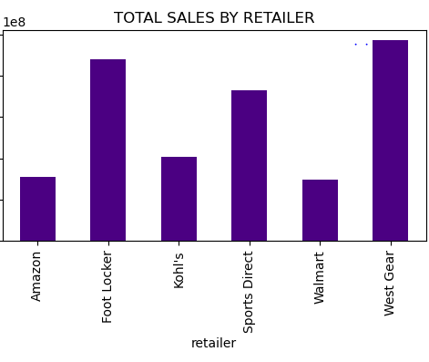
SALES PERFOMANCES BY RETAILERS
INSIGHTS: WEST GEAR Made the highest sales with a sum of ($242,964,333) while WALMART has the lowest sales with a sum of ($74,558,410).
WEST GEAR: $242,964,333.
FOOT LOCKER: $220,094,720.
SPORTS DIRECT: $182,470,997.
KOHL’S: $102,114,753.
AMAZON: $77,698,912.
WALMART: $74,558,410.

Slide 6
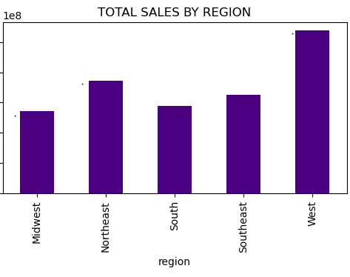
SALES PERFORMANCE BY REGION
INSIGHTS: West Region has the highest sales with a sum of ($269943182), while MIDWEST has the lowest sales with a sum of($135800459).
WEST: $269943182.
NORTHEAST: $186324067.
SOUTHEAST: $163171236.
SOUTH: $144663181.
MIDWEST: $135800459.

Slide 7
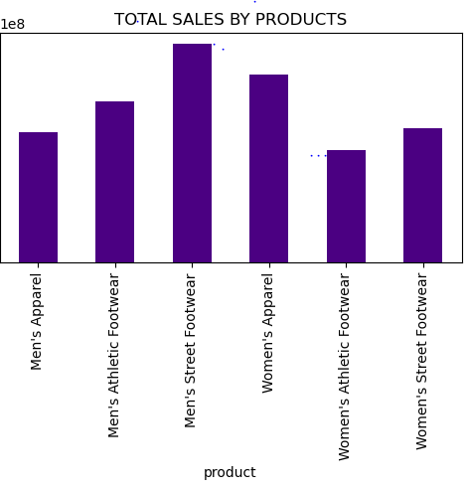
SALES PERFORMANCE BY PRODUCTS
INSIGHTS: MEN’S STREET FOOTWEAR has the highest sales while WOMEN’S ATHLETIC FOOTWEAR has the lowest sales.
PRODUCTS;
1.MEN’S STREET FOOTWEAR: $208826244.
2.WOMEN’S APPAREL: $179038860.
3.MEN’S ATHLETIC FOOTWAER: $153673680.
4.WOMEN’S STREET FOOTWEAR: $128002813.
5.MEN’S APPAREL: $123728632.
6.WOMEN’S ATHLETIC FOOTWEAR: $106631896.

Slide 8
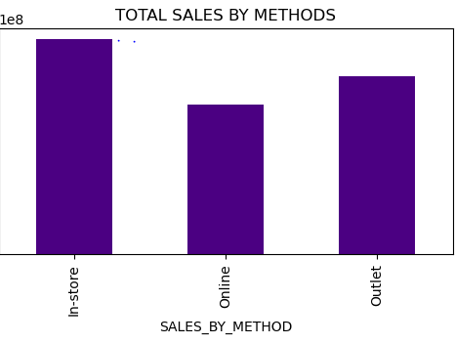
SALES PERFORMANCE BY METHOD
INSIGHTS: INSTORE has the highest sales with the sum of ($356643750) while ONLINE with lowest sales of ($247672882).
IN-STORE: $356643750.
OUTLET: $295585493.
ONLINE: $247672882.

Slide 9
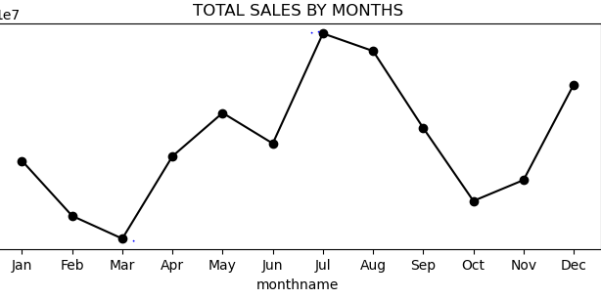
SALES PERFORMANCE BY MONTHS.
INSIGHTS: The highest sales was JULY($34,451,440), WHILE Lowest sale is MARCH($20,439,788).
MONTHNAME:
AUG: $34,451,440.39
JUL: $34,054,898.59
DEC: $31,590,202: 03
SEP: $31,009,586.73
MAY: $29,946256.33
APR: $27,559,237.31
JUN: $26,714,715.92
JAN: $25,141,934.51
OCT: $25,078,444.60
NOV: $24,755,21.43
FEB: $21,392,736.70
MAR: $20,439,788.70

Slide 10
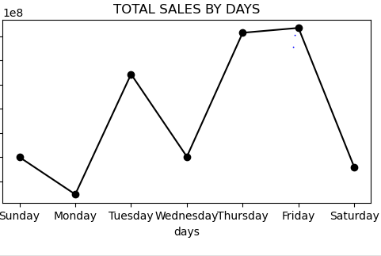
SALES PERFORMANCE BY DAYS.
INSIGHTS: The highest sales was FRIDAY($146,683,099), WHILE Lowest sale was on MONDAY($112,335,387).
DAYS:
1.FRIDAY: $ 146,683,099.
2.THURSDAY: $145,683,120.
3.TUESDAY: $137,138,087.
4.WEDNESDAY: $120,114,465.
5.SUNDAY: $120,017,988.
6.SATURDAY: $117,929,979.
7.SUNDAY: $112,335,387.

Slide 11
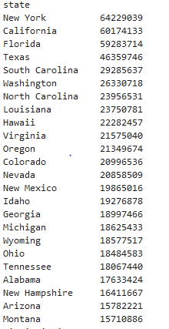
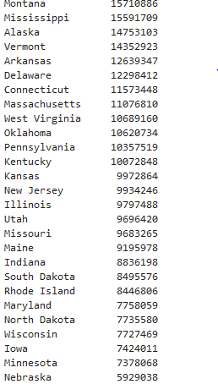
SALES PERFORMANCE BY STATE

Slide 12
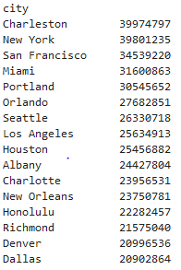
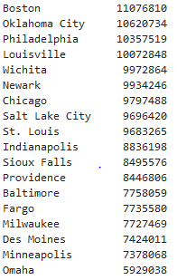
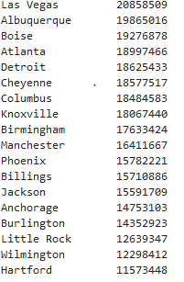
SALES PERFORMANCE BY CITY

Slide 13
INSIGHTS Adidas Sales Report 2020/2021: Key Achievements and Insights Achievements: 1. Total Sales and Units Sold: Total sales amounted to $899,902,125. Total units sold reached 2,478,861. Total profit achieved was $332,134,996. 2. Yearly Comparison: 2020: Total sales: $182,080,675. Total units sold: 462,349. Total profit: $63,375,662.58.

Slide 14
2021: Total sales: $717,821,450. Total units sold: 2,016,512. Total profit: $268,759,098.87. Insight: Sales in 2021 were approximately four times higher than in 2020. Sales by Method: In-Store Sales: $356,643,750 (highest sales). Outlet Store Sales: $295,585,493. Online Sales: $247,672,882 (lowest sales). Monthly Sales Trends: Highest Sales Month: July, with total sales of $95,480,694. Lowest Sales Month: March, with total sales of $56,809,109. By analyzing these insights, we can clearly understand the performance dynamics and trends in Adidas's sales for 2020 and 2021, allowing us to strategize effectively for future growth.

Slide 15
Advertising Recommendations Optimal Advertising Periods: (i.) Monthly Focus: Peak Month: JULY. Ramp up advertising efforts in May and June to capitalize on increased spending. Suggested Advertising Strategy: Pre-July Campaign: Start targeted campaigns in May and June to build anticipation for July. Weekend Push: Implement special promotions from Thursday to Friday to leverage higher Friday sales. Highlight limited-time offers and exclusive weekend deals. Online and In-Store Synergy: Integrate online promotions with in-store and outlet advertising to drive traffic across all channels. Use online ads to promote in-store exclusives and vice versa. By strategically timing and focusing advertising efforts, Adidas can maximize sales potential and maintain growth momentum throughout the year.

Slide 16
INNOVATIVE IDEAS PROBLEM STATEMENT: Traffic congestion in Nigerian cities leads to frustration, wasted time, and economic losses. SOLUTION: 1. Data Collection: Collect real-time data from traffic sensors, GPS devices, social media, and crowdsourced reports. 2. Data Integration: Combine data from these sources to get a complete view of traffic conditions. 3. Predictive Analytics:** Use machine learning to: - Identify traffic hotspots and congestion patterns - Predict real-time traffic flow and congestion 4. **Platform Development:** Build a user-friendly platform to: - Visualize traffic data - Provide real-time updates and alerts - Suggest optimized routes IMPACT: Reduce congestion, decrease travel times, and enhance commuter quality of life in Nigerian cities. Innovative Aspects: 1. Integration of diverse data sources for real-time insights 2. Use of machine learning for predictive analytics 3. User-friendly platform for actionable information Benefits: 1. Reduced congestion and travel times 2. Improved air quality and fuel efficiency 3. Enhanced productivity and quality of life 4. Data-driven urban planning and infrastructure development This approach leverages data analytics and technology to tackle traffic congestion in Nigerian cities, driving significant improvements.

